Slide 1

SUMMARISING NEWS ARTICLES: NATURAL LANGUAGE PROCESSING
PROJECT VIVA

Slide 2
Project Overview I
General Purpose
To Implement both modern and traditional methods of Text Summarisation for condensing CNN/Daily mail news articles. Assessing the quality of the summaries using the ROUGE Metric: calculates the overlap in words between the generated summaries and a set of ‘ground truth’ summaries from the text data.
What problem does it solve in the industry
Combating misinformation by filtering important content for more convenient news consumption(Improving the efficiency and accessibility of written articles )
News consumption is shifting to digital media, with younger people preferring to use online platforms/social media for news updates. Studies state that they are more attracted to summarized news articles.

Slide 3
Project Overview II
What makes my project unique (Key Features)?
A focus on how news companies can efficiently integrate Text Summarisation tools into existing systems by exploring barriers to implementation: specifically, High computational needs.
Experimentation with hybrid models (Modern and Traditional) in attempt to combat memory related issues when working with high volume text data and large models e.g.: Transformer models.
An Iterative approach to exploring Text Summarisation using Dimensionality reduction. Resulting in a total of 4 models.

Slide 4
Data Quality Control I
All aspects of this project were carried out using Python programming
THE DATA
This project uses the pre-labelled CNN-Daily Mail News Text summarisation dataset from Kaggle, this is available under a public domain license. The data was sourced from archives of both CNN and the Daily Mail using the Wayback Machine, a digital archive of the web.
DATA CLEANING
Data Leakage: The Training dataset was manually cleaned through inspection to verify that all uninformative text data was removed. The Test and Validation sets were cleaned using a function based on the transformations made on the Training data so that data from Test/ Validation sets would not get prematurely exposed to the model, causing less accurate results.
DATASET SPLIT | NUMBER OF RECORDS IN SPLIT
TRAIN: | 287,113
TEST: | 13,368
VALIDATION: | 11,490
COLUMN NAME | COLUMN CONTENT
ID (STRING) : | A unique mixture of alphanumeric characters
ARTICLE (STRING): | Contains the article content.
HIGHLIGHTS (STRING) : | A human generated summary of key information from the corresponding article.

Slide 5
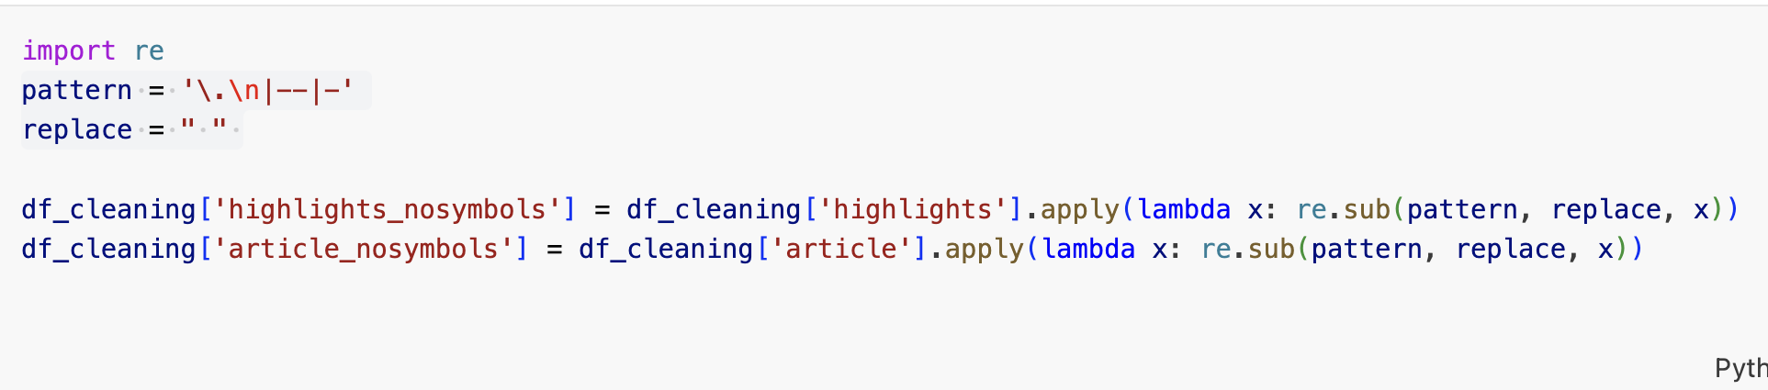
Data Quality Control II
Manual Cleaning Example:
EDA
EDA
The first step for understanding the data was conducting descriptive statistics. Descriptive statistics are statistical summaries of the data, they offer a numerical overview of its qualities.
The following descriptive statistics were carried out on the data : Mean token count, average word count and mode of word counts for each column.

Slide 6
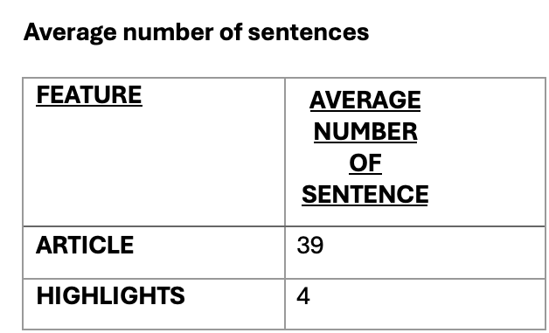
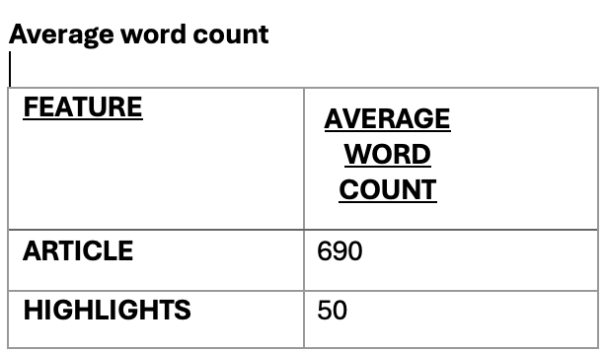
KEY EDA RESULTS
The following Summary Statistics were conducted: Mean Token count, Average word count, Most frequent occurring word count and Average number of sentences.

Slide 7
Project Framework Overview
MODEL 1 (BASELINE)- LEAD-3 BENCHMARK
Document →Implement the algorithm → evaluate the model summary
MODEL 2: BART (BIDIRECTIONAL AND AUTO-REGRESSIVE TRANSFORMERS) AND T5 (TEXT-TO-TEXT TRANSFER TRANSFORMER)
Dataset → Preprocessing → Model Training → Evaluation → Summary Generation
MODEL 3 : PRETRAINED T5 (TEXT-TO-TEXT TRANSFER) TRANSFORMER AND LSA (LATENT SEMANTIC ANALYSIS)
Document → Preprocessing → LSA → LSA model output summaries → evaluate the LSA summaries → apply transformer model to the LSA summaries → evaluate the Hybrid summaries
MODEL 4 : PRETRAINED T5 (TEXT-TO-TEXT TRANSFER TRANSFORMER) AND LSA (LATENT SEMANTIC ANALYSIS) WITH LDA (LATENT DIRICHLET ALLOCATION)
Document → Preprocessing→ LSA →LSA model output summaries → evaluate the LSA summaries → apply transformer model to the LSA summaries →evaluate the Hybrid summaries→ Latent Dirichlet Allocation (LDA) → evaluate the model output

Slide 8
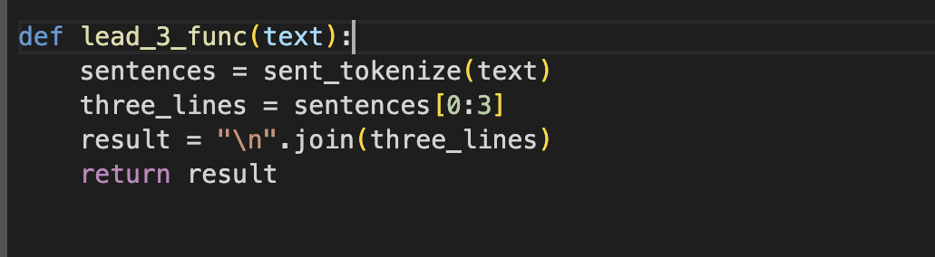
Key Functionality
MODEL 1 (BASELINE)- LEAD-3 BENCHMARK
Sentence level summarisation: Summaries using the Lead-3 benchmark were created through Extractive summarisation by pulling the first three sentences of the chosen texts to form a short summary.
This model was used to show the minimum level of performance for a Text summarisation model. The subsequent models of this project were compared to this baseline.

Slide 9
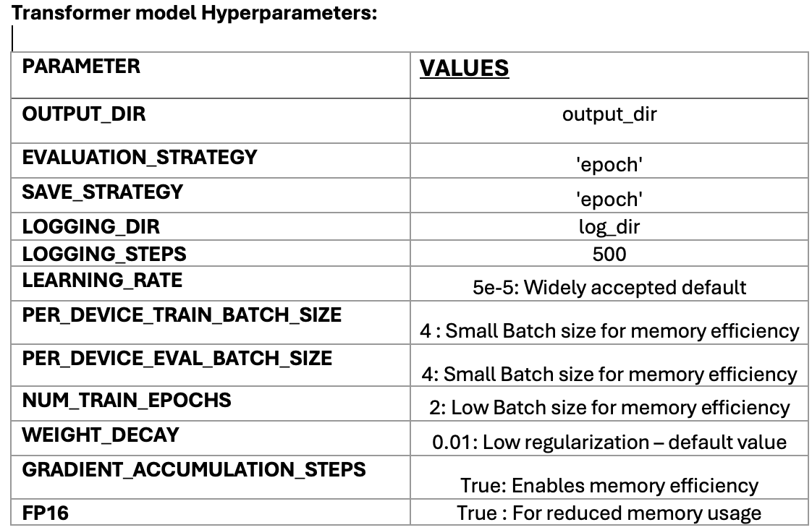
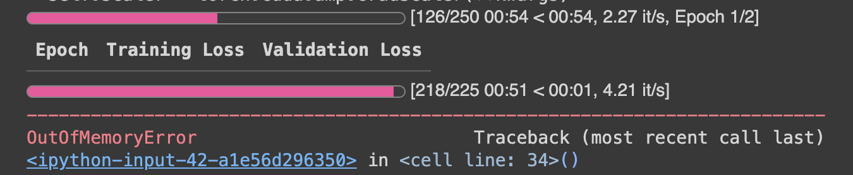
MODEL 2: BART (BIDIRECTIONAL AND AUTO-REGRESSIVE TRANSFORMERS) AND T5 (TEXT-TO-TEXT TRANSFER TRANSFORMER)
BART : Uses a seq2seq architecture with a bidirectional encoder, and a left-to-right decoder. This makes BART for both generating and understanding text.
T5 : Uses an encoder and decoder system which makes it good for summarisation and translation tasks.
Intention: Implement Transfer Learning through fine tuning a pretrained model using specific hyperparameters.
BART-base was initially selected for its strong performance, but using it resulted in significant memory issues during training. BART-base was switched to the smaller T5-small model, which reduced some memory constraints, but this temporary solution still encountered limitations with finalising training. Memory issues persisted throughout the training process.

Slide 10
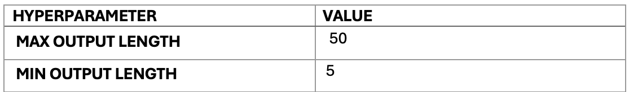
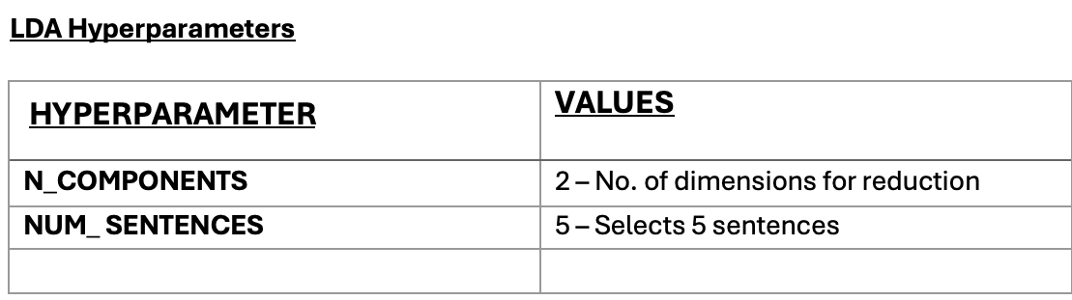
Key Functionality
MODEL 3 : PRETRAINED T5 (TEXT-TO-TEXT TRANSFER) TRANSFORMER AND LSA (LATENT SEMANTIC ANALYSIS)
Using LSA for dimensionality reduction for faster computation. The Transformer model which uses both Abstractive generation for attempting to add more meaningful wording to the summaries.
The Hyperparameters controlled the length of the summaries. The summaries could not be shorter than 50 tokens. 50 tokens are around 3-5 sentences, whilst 5 tokens are 1-2 short sentences.
MODEL 4 : PRETRAINED T5 (TEXT-TO-TEXT TRANSFER TRANSFORMER) AND LSA (LATENT SEMANTIC ANALYSIS) WITH LDA (LATENT DIRICHLET ALLOCATION)
LDA was used to further validate the results obtained from using The ROUGE score

Slide 11
Results and Discussion
ROUGE scores range from 0 to 1, where 1 (100%) is considered a perfect score.
METRIC | MODEL 1 (BASELINE) | MODEL 2 (BART + T5) | MODEL 3 (PRETRAINED T5 + LSA) | MODEL 3 (LSA ALONE) | MODEL 4 (T5 + LSA + LDA)
ROUGE-1 | 34.88 | N/A | 0.27 | 0.25 | LDA
ROUGE-2 | 14.60 | N/A | 0.09 | 0.08 | LDA
ROUGE-L | 22.37 | N/A | 0.18 | 0.15 | LDA
ROUGE-LSUM | 26.33 | N/A | 0.18 | 0.15 | LDA

Slide 12
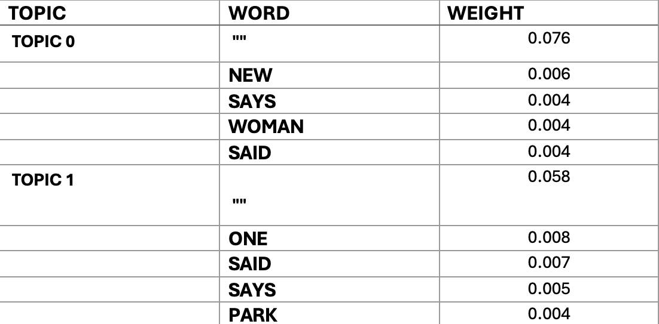
PRETRAINED T5 (TEXT-TO-TEXT TRANSFER TRANSFORMER) AND LSA (LATENT SEMANTIC ANALYSIS) WITH LDA (LATENT DIRICHLET ALLOCATION)
LDA TOPICS RESULTS

Slide 13
Challenges & Solutions
Time Limitations for Learning and Implementation
I was required to proactively learn about Transformer models. This tedious process of constructing and deconstructing code was dealt with through embracing a methodical approach to problem solving.
Lack of Computational Resources ( Both personal computer and University Computers)
when attempting to build a Transformer model, the capabilities of my personal computer were exhausted, leading to the need to use paid Google Collab services. Collab Pro still imposed limitations on available resources which severely depleted my options when training my Transformer model.
The solution was to substantially downsize my model by switching from BART to T5-small. This solution was not completely effective, but it helped me to speed up the development of model code.
Discussion of ethics and legality
Human Generation of ‘Ground Truth Summaries’
The possibility of human error in creating the text data ‘Highlights’. The summaries could further human bias because they are subject to the evaluator’s personal judgment of the news article. a biased evaluator could potentially skew the results obtained from the data either intentionally or unintentionally .
Oversimplification
The misrepresentation of journalists through the oversimplification of complex subjects. Text Summarisation can cause the true intentions of journalist to be lost in translation.
Intellectual property and misrepresentation
Legal issues could arise if journalists feel that their ideas have been misrepresented through the model.

Slide 14
Future Work
A significant limitation of this project was the lack of sufficient computational memory resources for thorough model training.
Future work would focus on accessing the necessary resources to complete the experiments proposed for Model 2, as well as exploring larger Transformer models such as PEGASUS.
This would also allow for processes such as hyperparameter tuning with tools like Ray Tune for improving the quality and accuracy of summaries.
Potential creation of a user application for real-time interaction with the summarisation model.

